Slide 1

Jason Killam
@killamjr

Slide 2
Intro
Work at Jack Henry and Associates for three years in Digital Forensics and Incident Response (DFIR)
Mostly performing forensics on live machines
SANS GCFA, GCFE
Nine Years in the Marines as a Data Network Specialist.
Currently an Air Force Reservist working as a Cyber Warfare Specialist
IT Support for my parents

Slide 3

What is the Registry?
The windows registry is basically the location where settings for programs are stored for windows.
Older versions of windows prior to 3.1 used individual .ini files for each program
Data is stored in folder like structures called keys
Keys contain entries for data, such as startup settings and recently opened files and folders.
Root Keys: contain data for the machine.
HKLM – local machine data
HKU – user data
HKCU – data for the current user

Slide 4

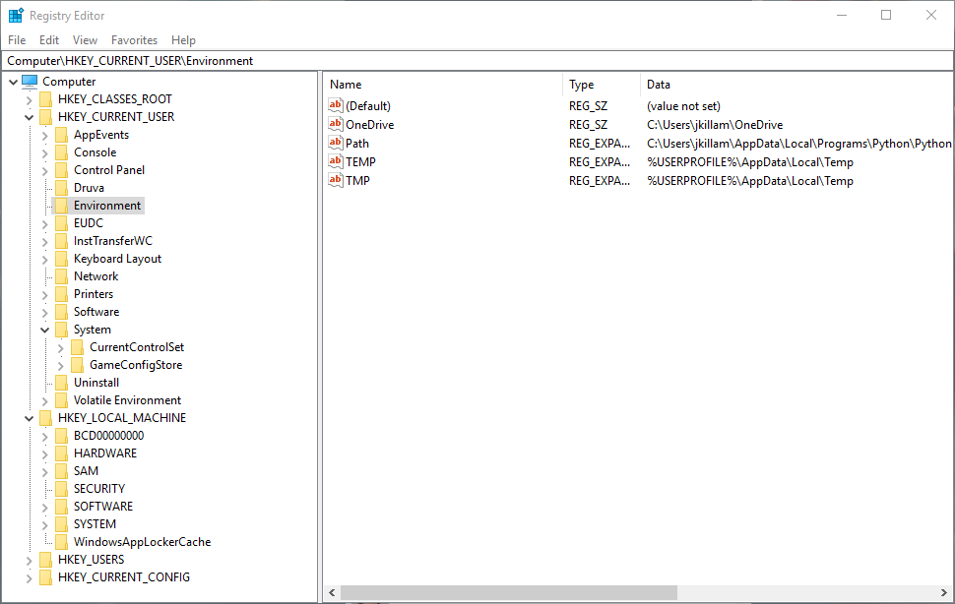
Registry

Slide 5
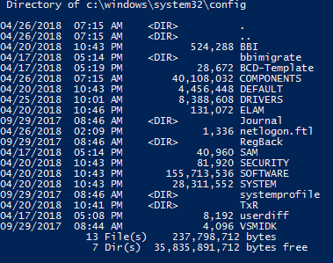
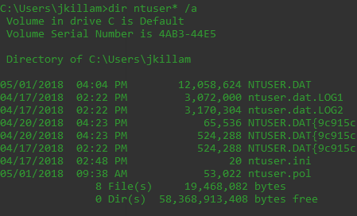
File Locations
NTUSER.dat – contains user specific data
C:\Users\{UserName}\NTUSER.DAT
NTUSER.dat.LOG files contain transactional data not yet written
SOFTWARE, SAM, SECURITY, SYSTEM – contains the HKLM subkey data
C:\Windows\System32\config
RegBack Contains backed up settings

Slide 6
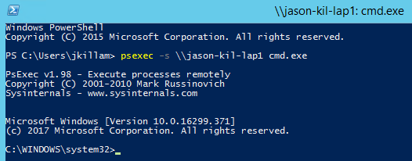

PSEXEC vs PowerShell Remoting
The easiest way to gather information from a live host is with a remote shell
PSEXEC/cmd can be preferable if you are used to using regular command prompt
PowerShell remote shell sessions are usually considered a little bit better since tools like mimikatz can be used to extract creds

Slide 7
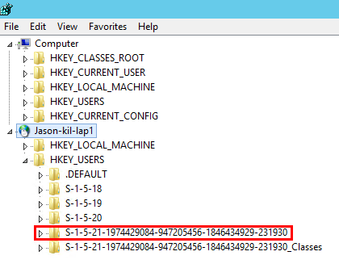
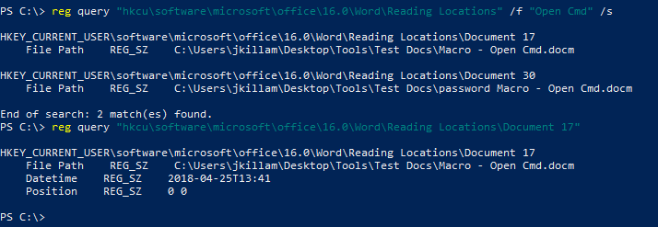
regedit and reg query
Reg query with /f lets you search for keywords
Connect to remote computers with File>Connect Network Registry and give it the target computer name or IP
Opening HKU>Security Identifier (SID) is the same thing as HKCU

Slide 8
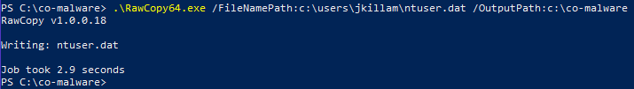
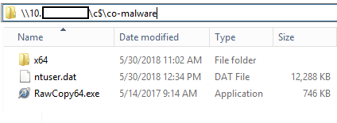
Collecting Files From Live Hosts
Since these files will always be in use on an active host you won’t be able to copy/paste.
RawCopy gets around this and can be run from the command line
Raw copy must be run locally, once its run it can be transferred easily over the network across a file share
https://github.com/jschicht/RawCopy

Slide 9

Tools to View Registry Files
Tools for live machines:
Regedit – Great for visually viewing keys and data
Reg – works from command line remote sessions, much faster at queries.
Get-RegistryKeyLastWriteTime – Powershell script, retrieves a timestamp from a specific machine key
Search “Boe Prox” Registry timestamp
Tools for offline machines/exported files
Registry Explorer – Import registry files and dynamically search
RegRipper – Collects different keys of interest, useful for when you don’t know what you’re looking for
Many Others

Slide 10
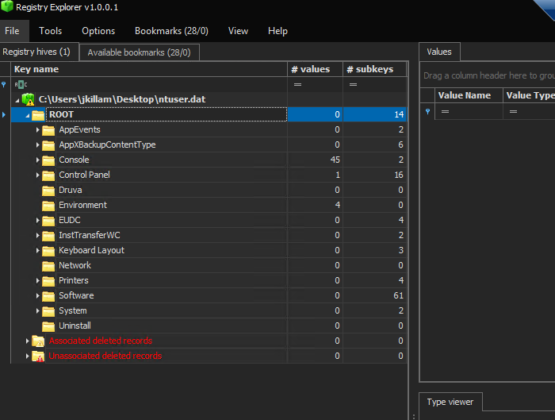
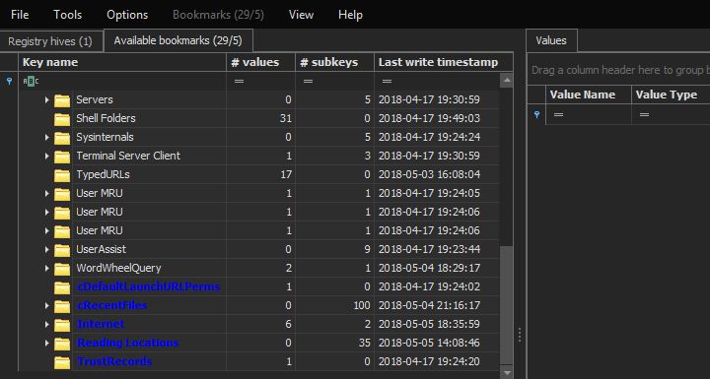

Registry Explorer
Created by Eric Zimmerman
Makes searching registry files super easy, very customizable
Make sure to collect LOG files to update the transactional data
Can search using simple strings, Regex, a time window and much more.
Search results can be dynamically sorted and organized
https://ericzimmerman.github.io/

Slide 11
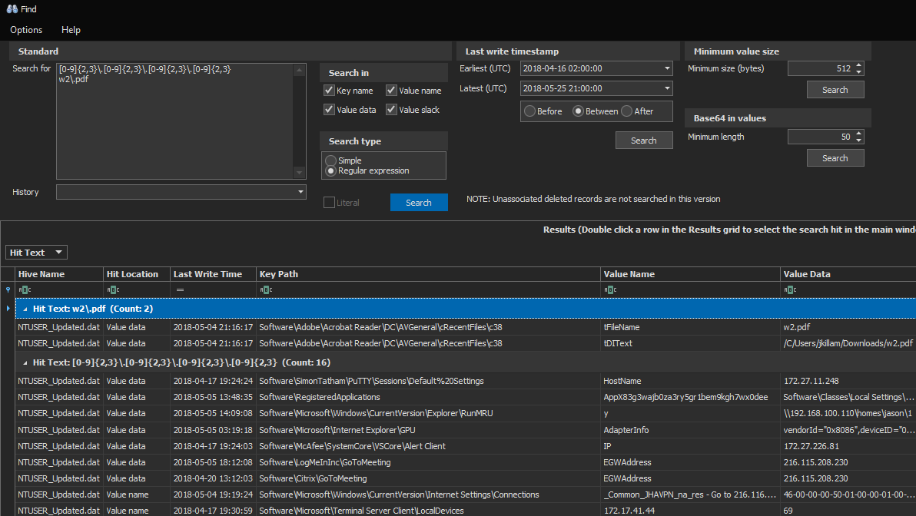
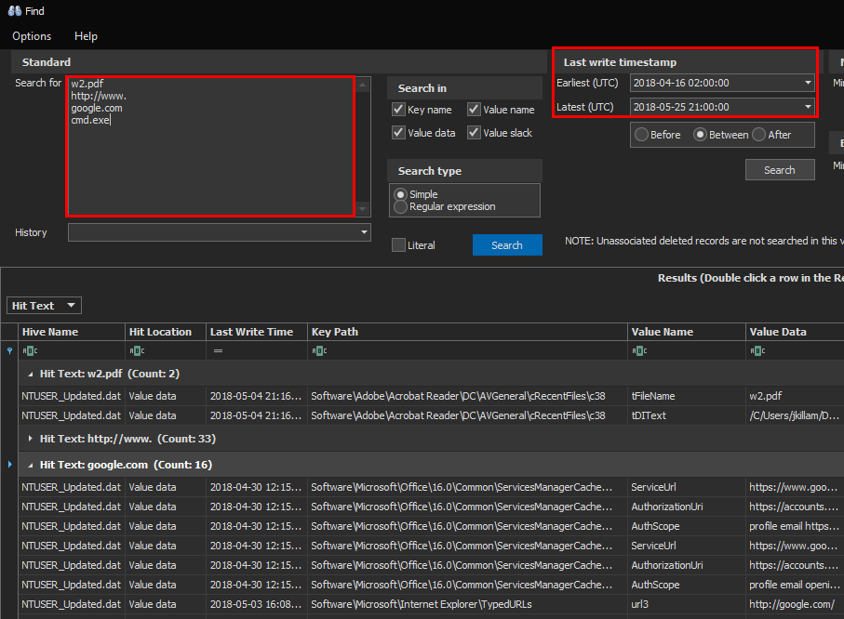
Registry Explorer Queries

Slide 12
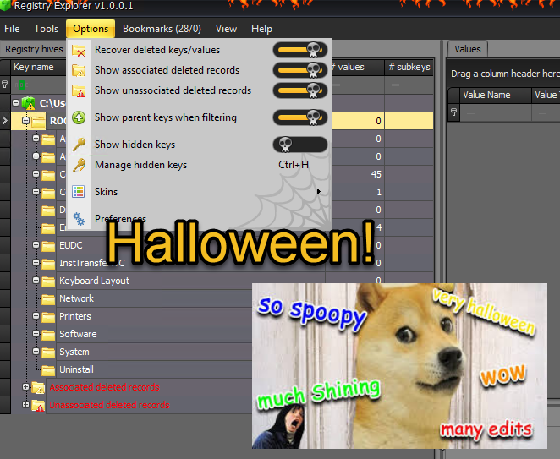
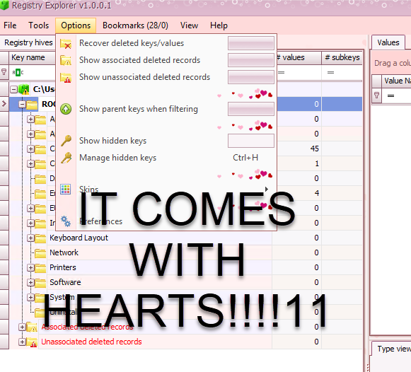
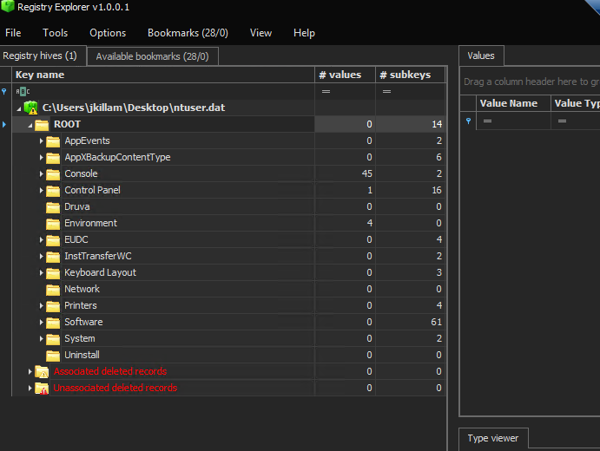
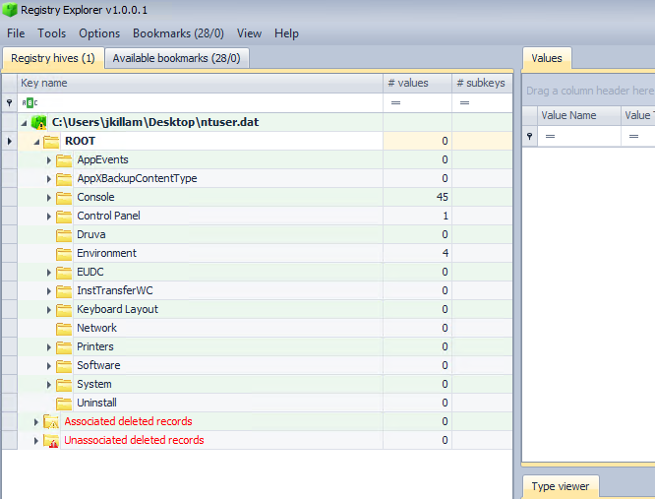
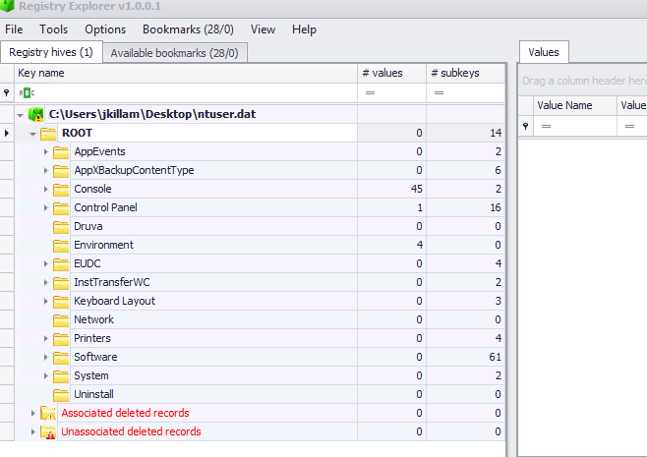
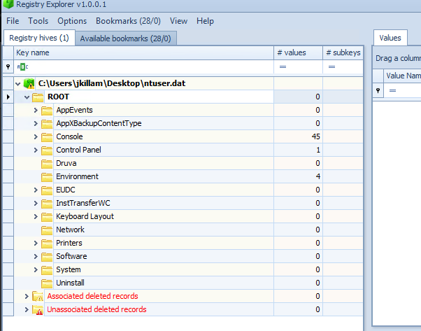
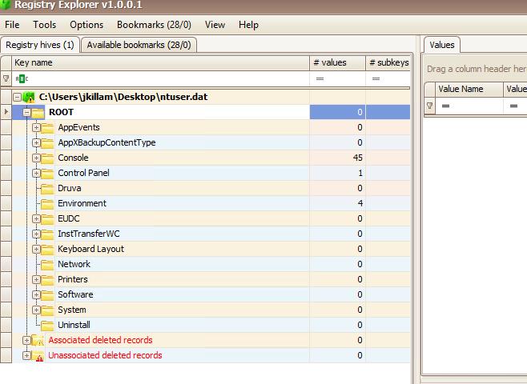
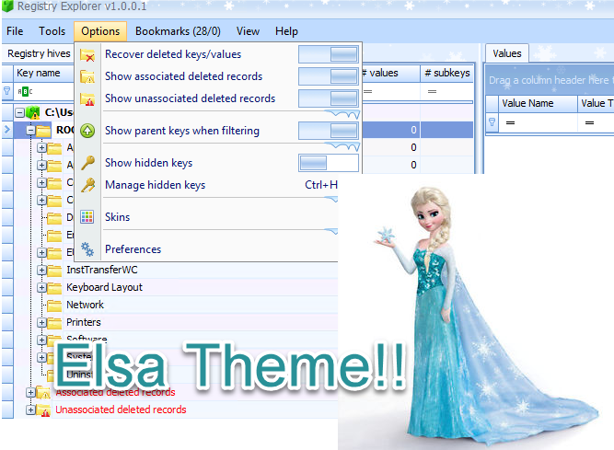
Registry Explorer (cont.)
Also, YOU CAN CHOOSE THE COLORS!!!

Slide 13
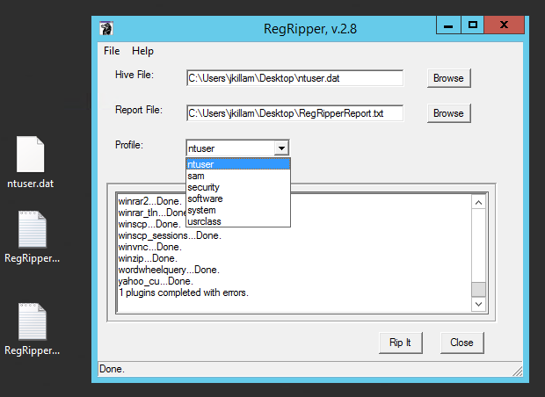
RegRipper
Created by Harlan Carvey
Creates a text report of a registry file
Great tool for when you want to pull out the “Greatest Hits” or common registry information that might be of interest.
Helpful for when you need a starting point.
https://github.com/keydet89/RegRipper2.8

Slide 14
Some Examples We’ll Go Over
PDF Phishing
Word Macros
URLs clicked from Office

Slide 15
Reg Keys of Interest for PDFs
Lots of phishing links are delivered by single link pdfs
When a link is clicked Adobe Reader, the domain is added to a “Trusted Hosts” lists which is great for proving a user clicked on a link to a phishing domain
HKCU\SOFTWARE\Adobe\Acrobat Reader\DC\TrustManager\cDefaultLaunchPerms
cRecentFiles Reg key prove that a user opened the pdf
HCKU\Adobe\Acrobat Reader\DC\AVGeneral\cRecentFiles
Each subkey contains an entry for a file opened and a timestamp

Slide 16
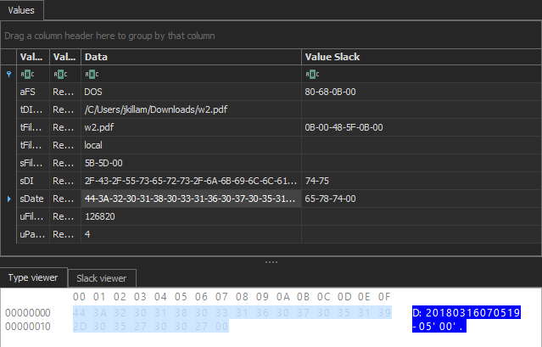
Opened PDFs
Key contains subkeys with entries for each file
Contains the file location, timestamp
Each key entry always contains a system timestamp as well
Location:
HCKU\Software\Adobe\Acrobat Reader\DC\AVGeneral\cRecentFiles

Slide 17
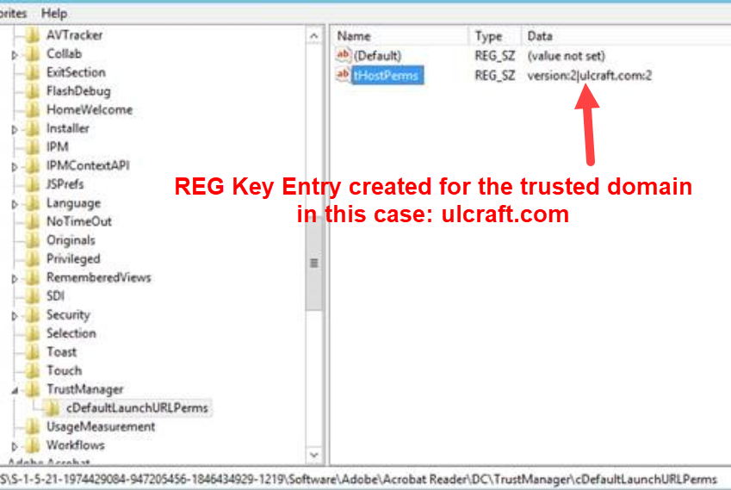
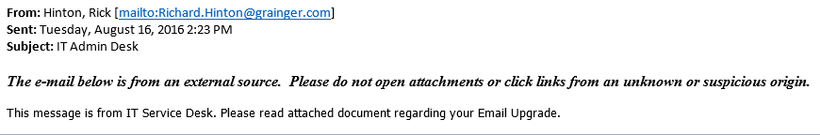
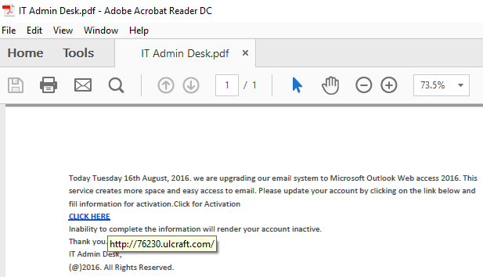
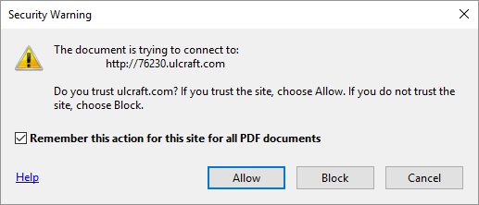
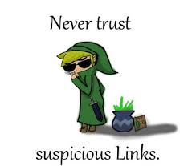
PDF Phishing Link
1. User Receives email from the “Help Desk”
2. User Opens PDF
3. A prompt from Adobe Reader DC prompts the user if they want to open the URL
4. Reg Key is written to recording the user “Trusted” site

Slide 18
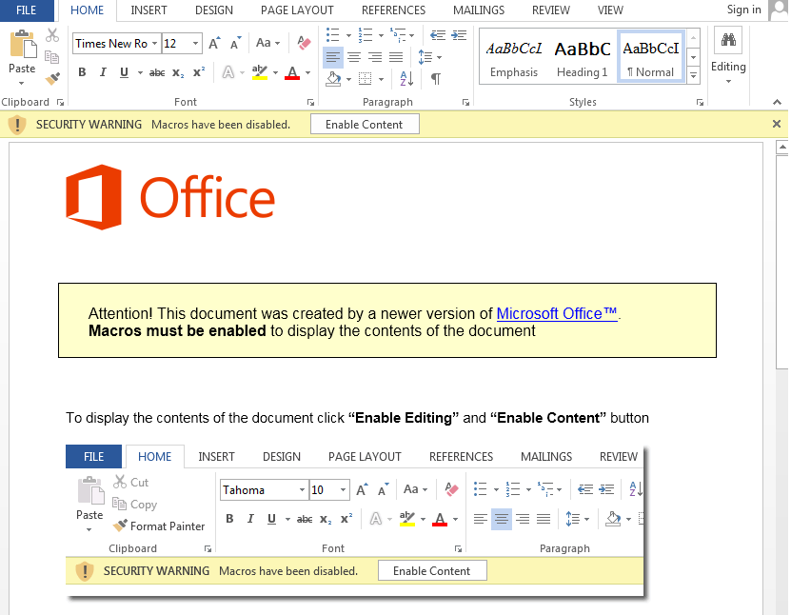
Malicious Documents
Most malicious documents usually rely on macros for payload execution
Registry entries occur when:
Being opened
Using edit (non-preview mode)
Enabling of macros

Slide 19
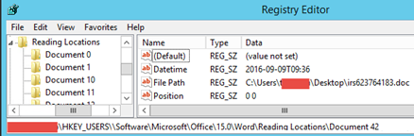
Opened Documents Reg Keys
The Reading locations section records the best.
Recorded Data
File path
Time last opened
Location:
HKCU\Software\Microsoft\Office\15.0\Word\Reading Locations

Slide 20
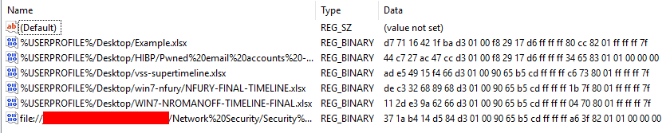
Enabled Macros Reg Keys
When “Enable Content” is clicked in a document it changes the Value of a file’s data section from all zero’s to “ff ff ff 7f”
This indicates to Office that the document is “Trusted” and to always enable the content when opened.
Location:
HKCU\Software\Microsoft\Office\16.0\Excel\Security\Trusted Documents\TrustRecords
HKCU\Software\Microsoft\Office\16.0\Word\Security\Trusted Documents\TrustRecords

Slide 21
Phishing Links
Emails with a link to a phishing site don’t leave behind as much evidence on the host compared to other events
But MS Office records the last link clicked
Downside - This information is very volatile since its overwritten each time a link is clicked
HKCU\Software\Microsoft\Office\16.0\Common\Internet

Slide 22
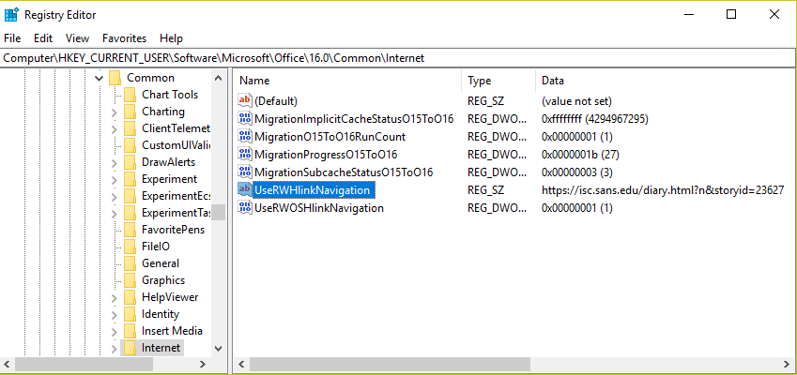
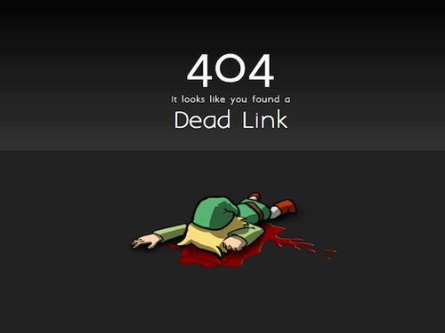
Reg Keys for Clicked Links
One of the most convenient keys for researching phishing links from emails
Anytime an link is clicked from an Office application the full URL is recorded
Location:
HKCU\Software\Microsoft\Office\16.0\Common\Internet

Slide 23
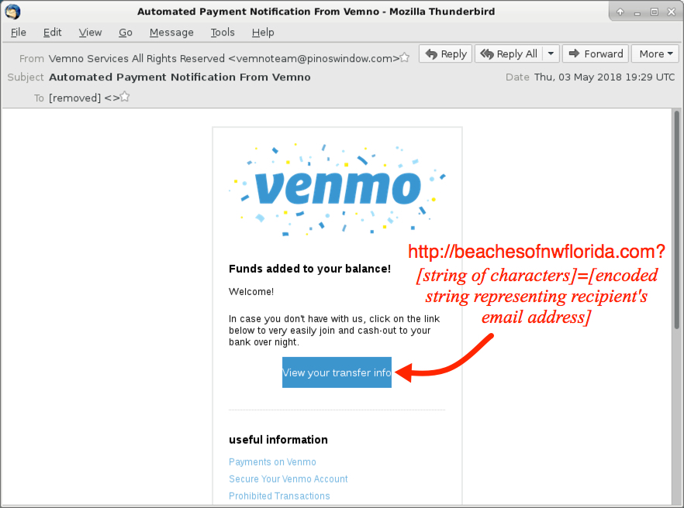
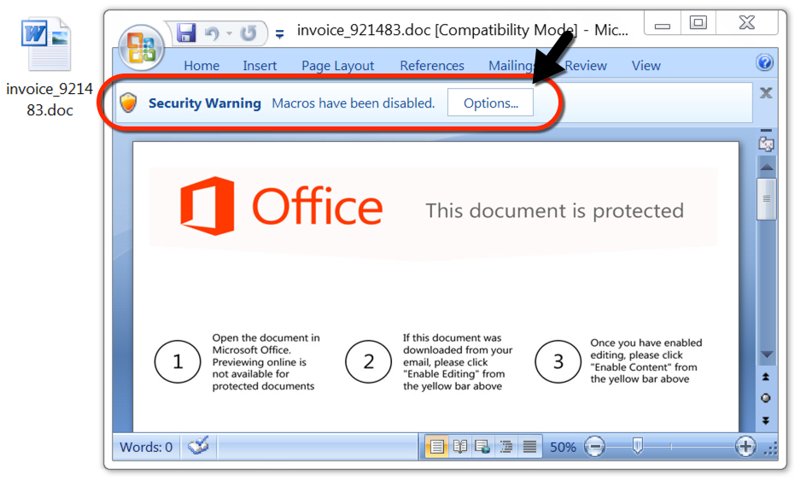
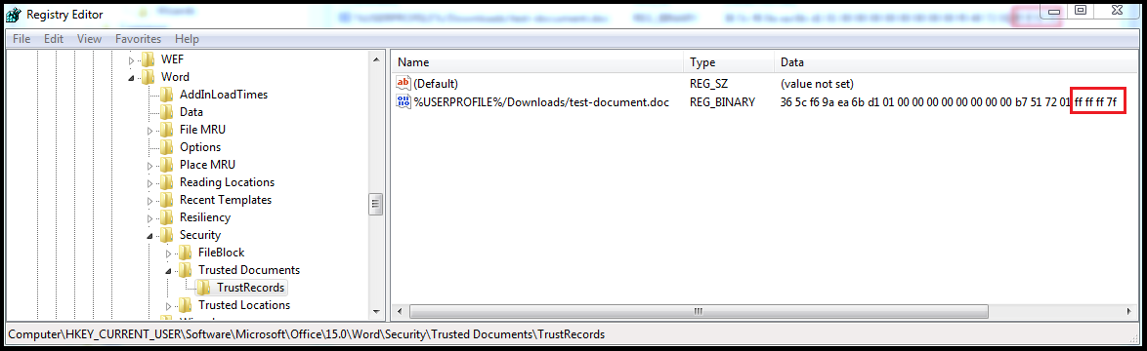
Malicious Word Doc Timeline
User receives an email and clicks on the link from the email
\Common\Internet UseRWHlinkNavigation Key is written to with the URL
2. User downloads and opens the document
\Reading Locations\Document ## Hive is written to with key data values for the file name and time opened
3. User clicks Enable Content
\TrustedDocuments\TrustRecords entry created

Slide 24
Summary
Some key data be very volatile, so collect data as soon as possible
Make sure you’re looking in the correct Hive
The subkeys for some Hives can look very similar initially
Delete any files you’re creating on the host, since this might cause the user to get confused or suspicious
PSEXEC with cmd can be easier to work with if you’re used to the regular command prompt
Also viewing the recycle bin on works from a traditional command prompt
PowerShell remote sessions have handier features like autocomplete
It’s safer to use since mimikatz can’t export creds
Commands are logged

Slide 25
Questions?

